Slide 1
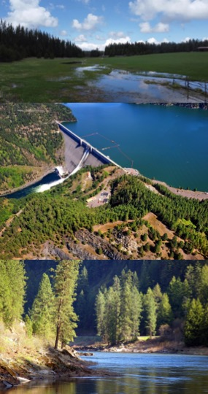

Advancing Water Quality Modeling for Effective Prediction and Management of Harmful Algal Blooms
Todd Steissberg, PhD, PE
Environmental Laboratory
U.S. Army Engineer Research and Development Center (ERDC)
Co-Authors:
Emily Summers (Texas A&M)
Isaac Mudge (USACE-MVN)
Jodi Ryder (ERDC-EL)
Lauren Melendez (ERDC-EL)
International Soil and Water Assessment Tool (SWAT) Conference
July 11, 2024

Slide 2
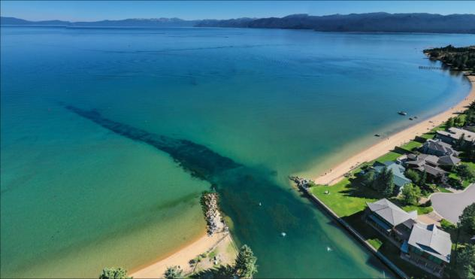
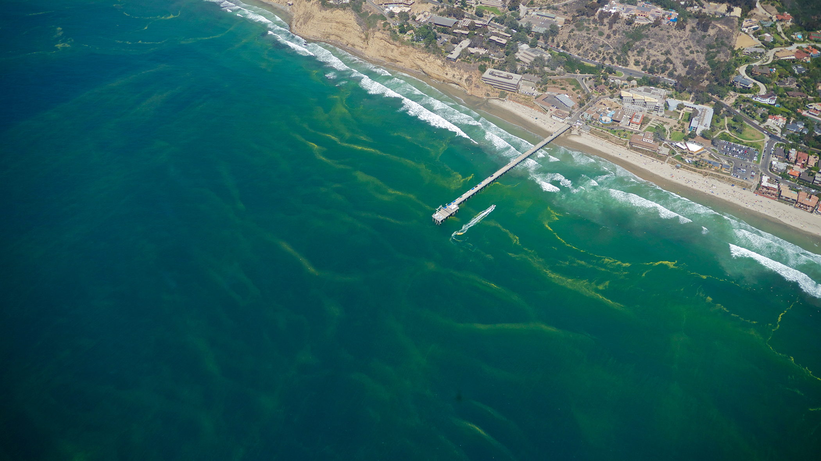
Introduction
Harmful Algal Blooms (HABs) occur when colonies of algae grow out of control and produce toxic or harmful effects on people, fish, shellfish, mammals, and birds.
Algae blooms can deplete dissolved oxygen in the water and/or release toxins that are harmful to human and ecosystem health through exposure to contaminated water or affected seafood.
The algae in toxic blooms can produce neurotoxins which directly affect fish and other marine life leading to massive fish kills and the accumulation of toxins in the food chain.

Slide 3
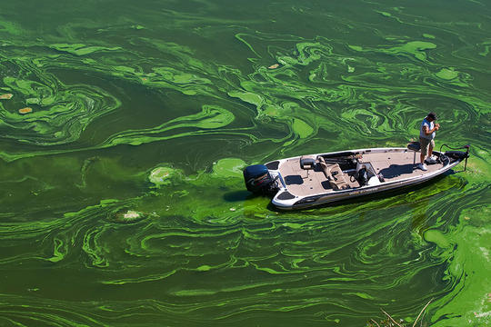
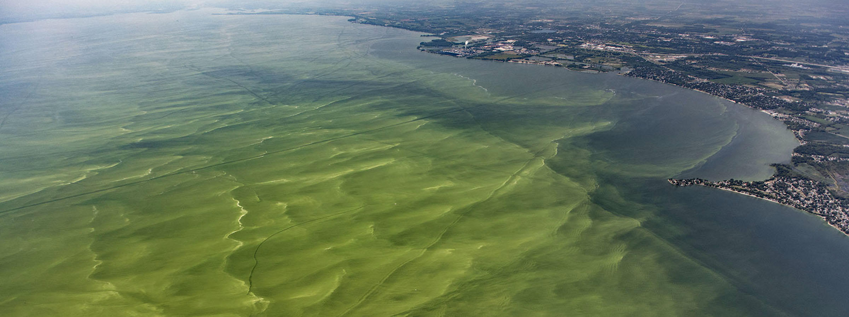
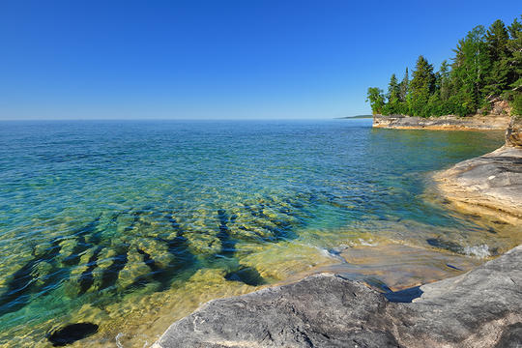
Introduction
Problem: Existing models inadequately predict the timing, frequency, intensity, spatial variability, and impacts of Harmful Algal Blooms (HABs).
Solution: A predictive HAB planning tool is being developed using ERDC’s reservoir water quality model, CE-QUAL-W2.

Slide 4
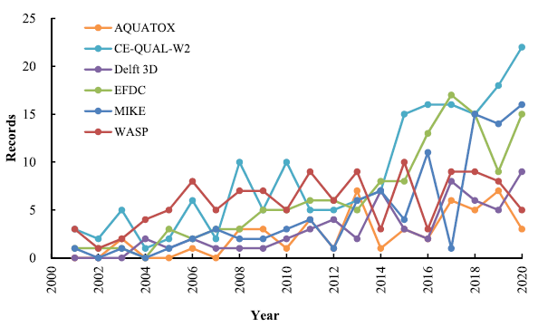
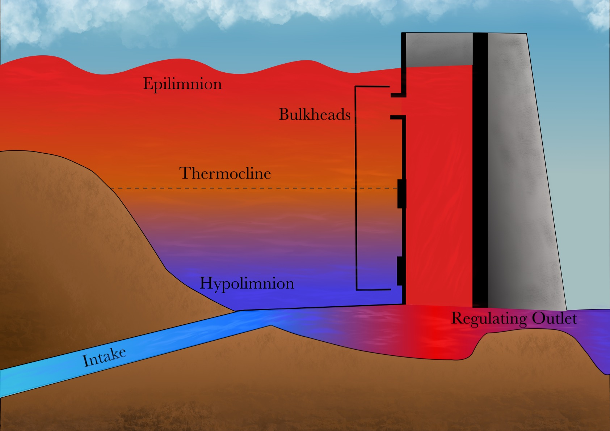
CE-QUAL-W2
CE‐QUAL‐W2 is a two‐dimensional (2D), longitudinal/vertical, hydrodynamics and water quality model that enables characterization of vertical and longitudinal changes in reservoirs.
The model assumes reservoirs are well mixed laterally, with no variation from one channel side to the other in a layer (vertical) and segment (longitudinal).
CE-QUAL-W2 has been applied to rivers, lakes, reservoirs, and estuaries.
Ecological Modelling 466 (2022) 109888

Slide 5

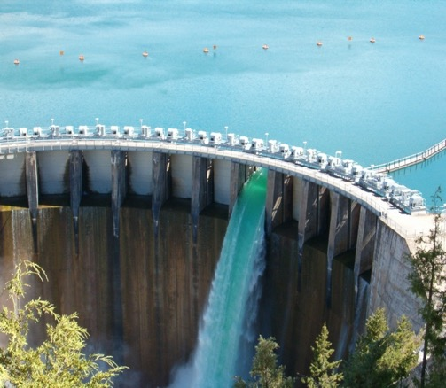
CE-QUAL-W2 Capabilities
Longitudinal-vertical hydrodynamics and water quality in stratified and non-stratified systems
Nutrients-dissolved oxygen-organic matter interactions
Fish habitat
Selective withdrawal from stratified reservoir outlets
Hypolimnetic aeration
Multiple algae, epiphyton/periphyton, zooplankton, and macrophytes
CBOD
Sediment diagenesis model
Generic water quality groups
Internal dynamic pipe/culvert model
Hydraulic structures (weirs, spillways) algorithms, including a dynamic shading algorithm based on topographic and vegetative cover.
Water age – Useful for forensic analyses

Slide 6
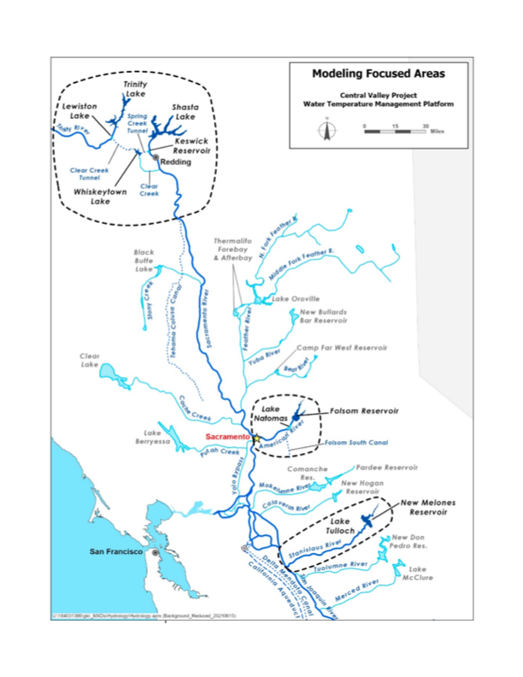
Past and Current Applications of CE-QUAL-W2
CE-QUAL-W2 is widely used by USACE and other federal, state, and local agencies for environmental impact assessments, planning studies, etc. Agencies that use CE-QUAL-W2 as their standard reservoir water quality model include:
U.S. Geological Survey (USGS)
U.S. Bureau of Reclamation
U.S. Environmental Protection Agency (EPA)
State of California
More than 1,100 model applications have been developed worldwide for reservoirs, rivers, estuaries, and other water bodies since CE-QUAL-W2 was released in 1986.
CE-QUAL-W2 is also used as a research tool by researchers at universities and other organizations.
At least 1,500 publications utilized or cited CE-QUAL-W2 in the year 2022 alone.
Recent Studies:
Water Temperature Modeling Platform, California Central Valley Project (USBR and State of California): This platform applies CE-QUAL-W2 for ongoing and future operations decision-making
USACE Northwest Division, Columbia and Snake River Watershed
Columbia System Reservoir Operation (CRSO) Project
Columbia River Treaty (CRT) Project
Philadelphia District, Lehigh River Water Quality Modeling
Region of Application:
Water Temperature Modeling Platform
California Central Valley Project

Slide 7
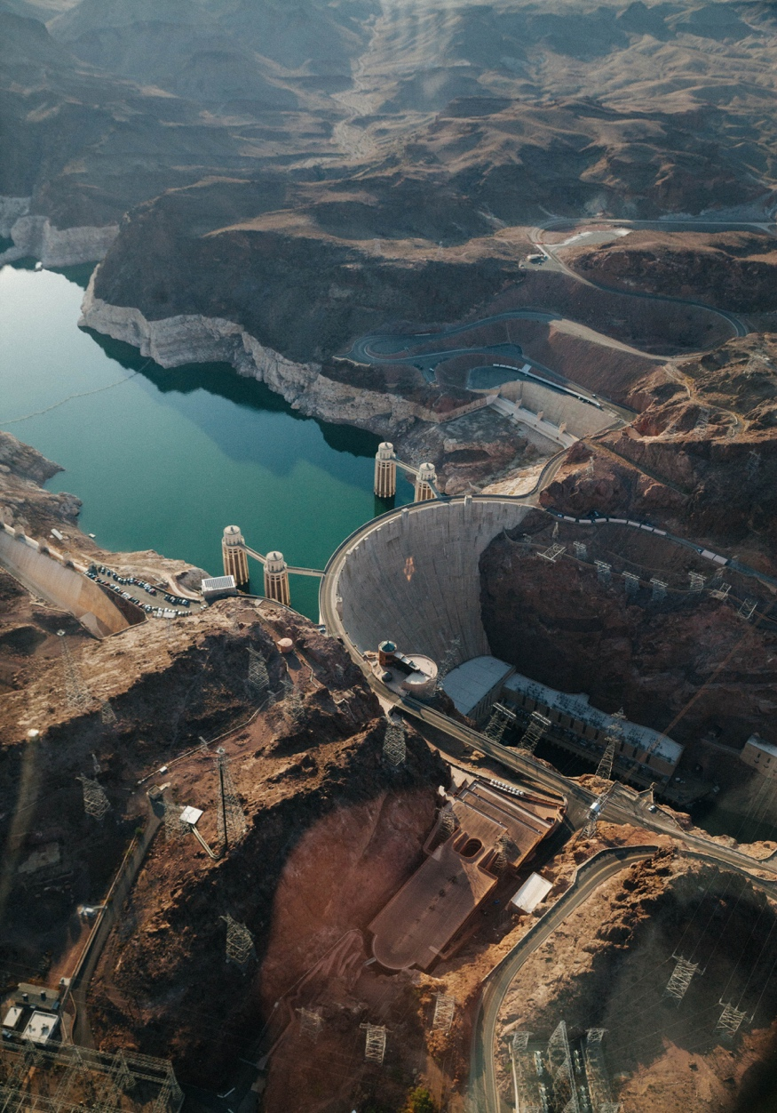
CE-QUAL-W2 Benefits
Since it was first released in 1986, CE-QUAL-W2 has been used by water quality managers to assess impacts of management strategies on reservoir, lake, and estuarine systems.
CE-QUAL-W2 computes the two-dimensional velocity field for narrow systems that stratify.
In contrast with reservoir models with simplified hydrodynamics, CE-QUAL-W2 accurately simulates vertical and longitudinal transport of constituents, which can be as important as chemical kinetics in accurately simulating water quality.
Applications of CE-QUAL-W2 include:
Planning Studies
Environmental Impact Assessments
Ecosystem Restoration Projects
Real-Time Systems Operation and Decision-Making

Slide 8

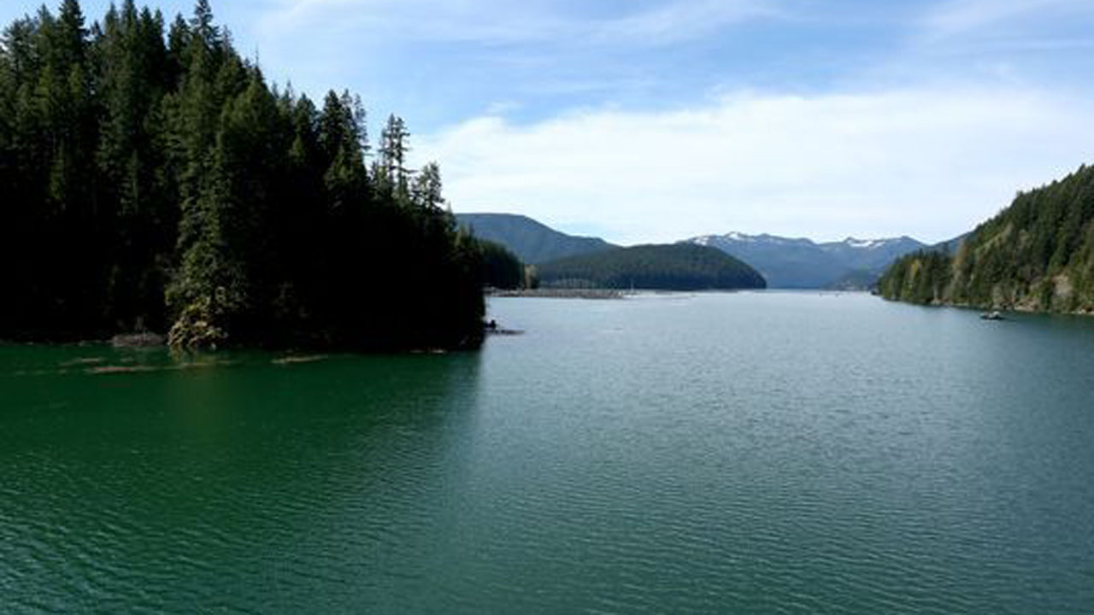
Challenges and Solutions
Developing HAB simulation capabilities applicable to any reservoir is challenging. Reservoirs have characteristics that can vary significantly:
Algal species
Water body morphometry (length, width, etc.)
Volume
Depth
Mixing dynamics (wind forcing, fetch orientation)
Harmful algal blooms can exhibit rapid changes and non-linear dynamics that are difficult to capture in model simulations.
To address these issues:
Extensive literature review. Feedback gathered from HAB experts.
Case study site (Detroit Lake) selected to provide adequate data and a range of conditions that enables development of scaling methods.
Single species selected for algorithm development. Will serve as a surrogate for prediction.
Detroit Lake, Oregon
Detroit Lake HAB

Slide 9
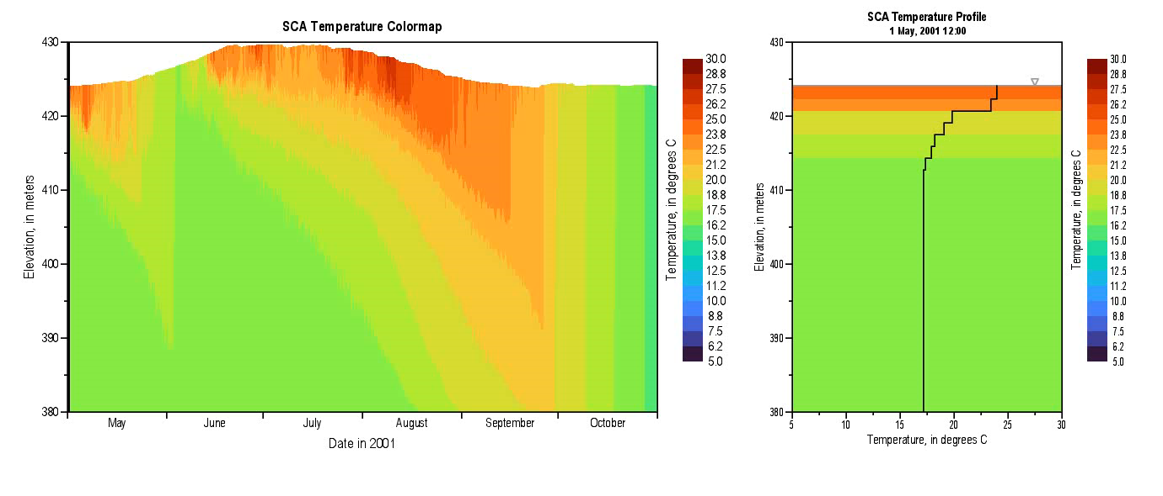
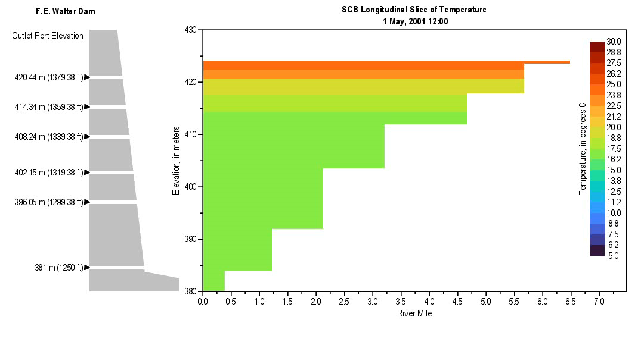
Method and Algorithm Research
Upwelling and boundary mixing dynamics
HABs are not spatially uniform
They are controlled by light penetration, temperature, and nutrient availability
Investigate the role of boundary mixing and upwelling on light penetration and HAB growth
Relate vertical mixing to HAB occurrence and intensity
Nondimensional numbers: Schmidt Stability Index, Wedderburn Number, Richardson Number

Slide 10
Method and Algorithm Research
CE-QUAL-W2 enhancements:
HAB species growth dynamics
Vertical diurnal migration
Nitrogen fixation algorithms (cyanobacteria may outcompete native algae since they can fix nitrogen)
Sub-grid modeling to capture lateral variability (post-processing tool)
Prediction tool:
Use CE-QUAL-W2 outputs and observed cross-sectional data to predict the maximum concentrations and locations of occurrence.

Slide 11
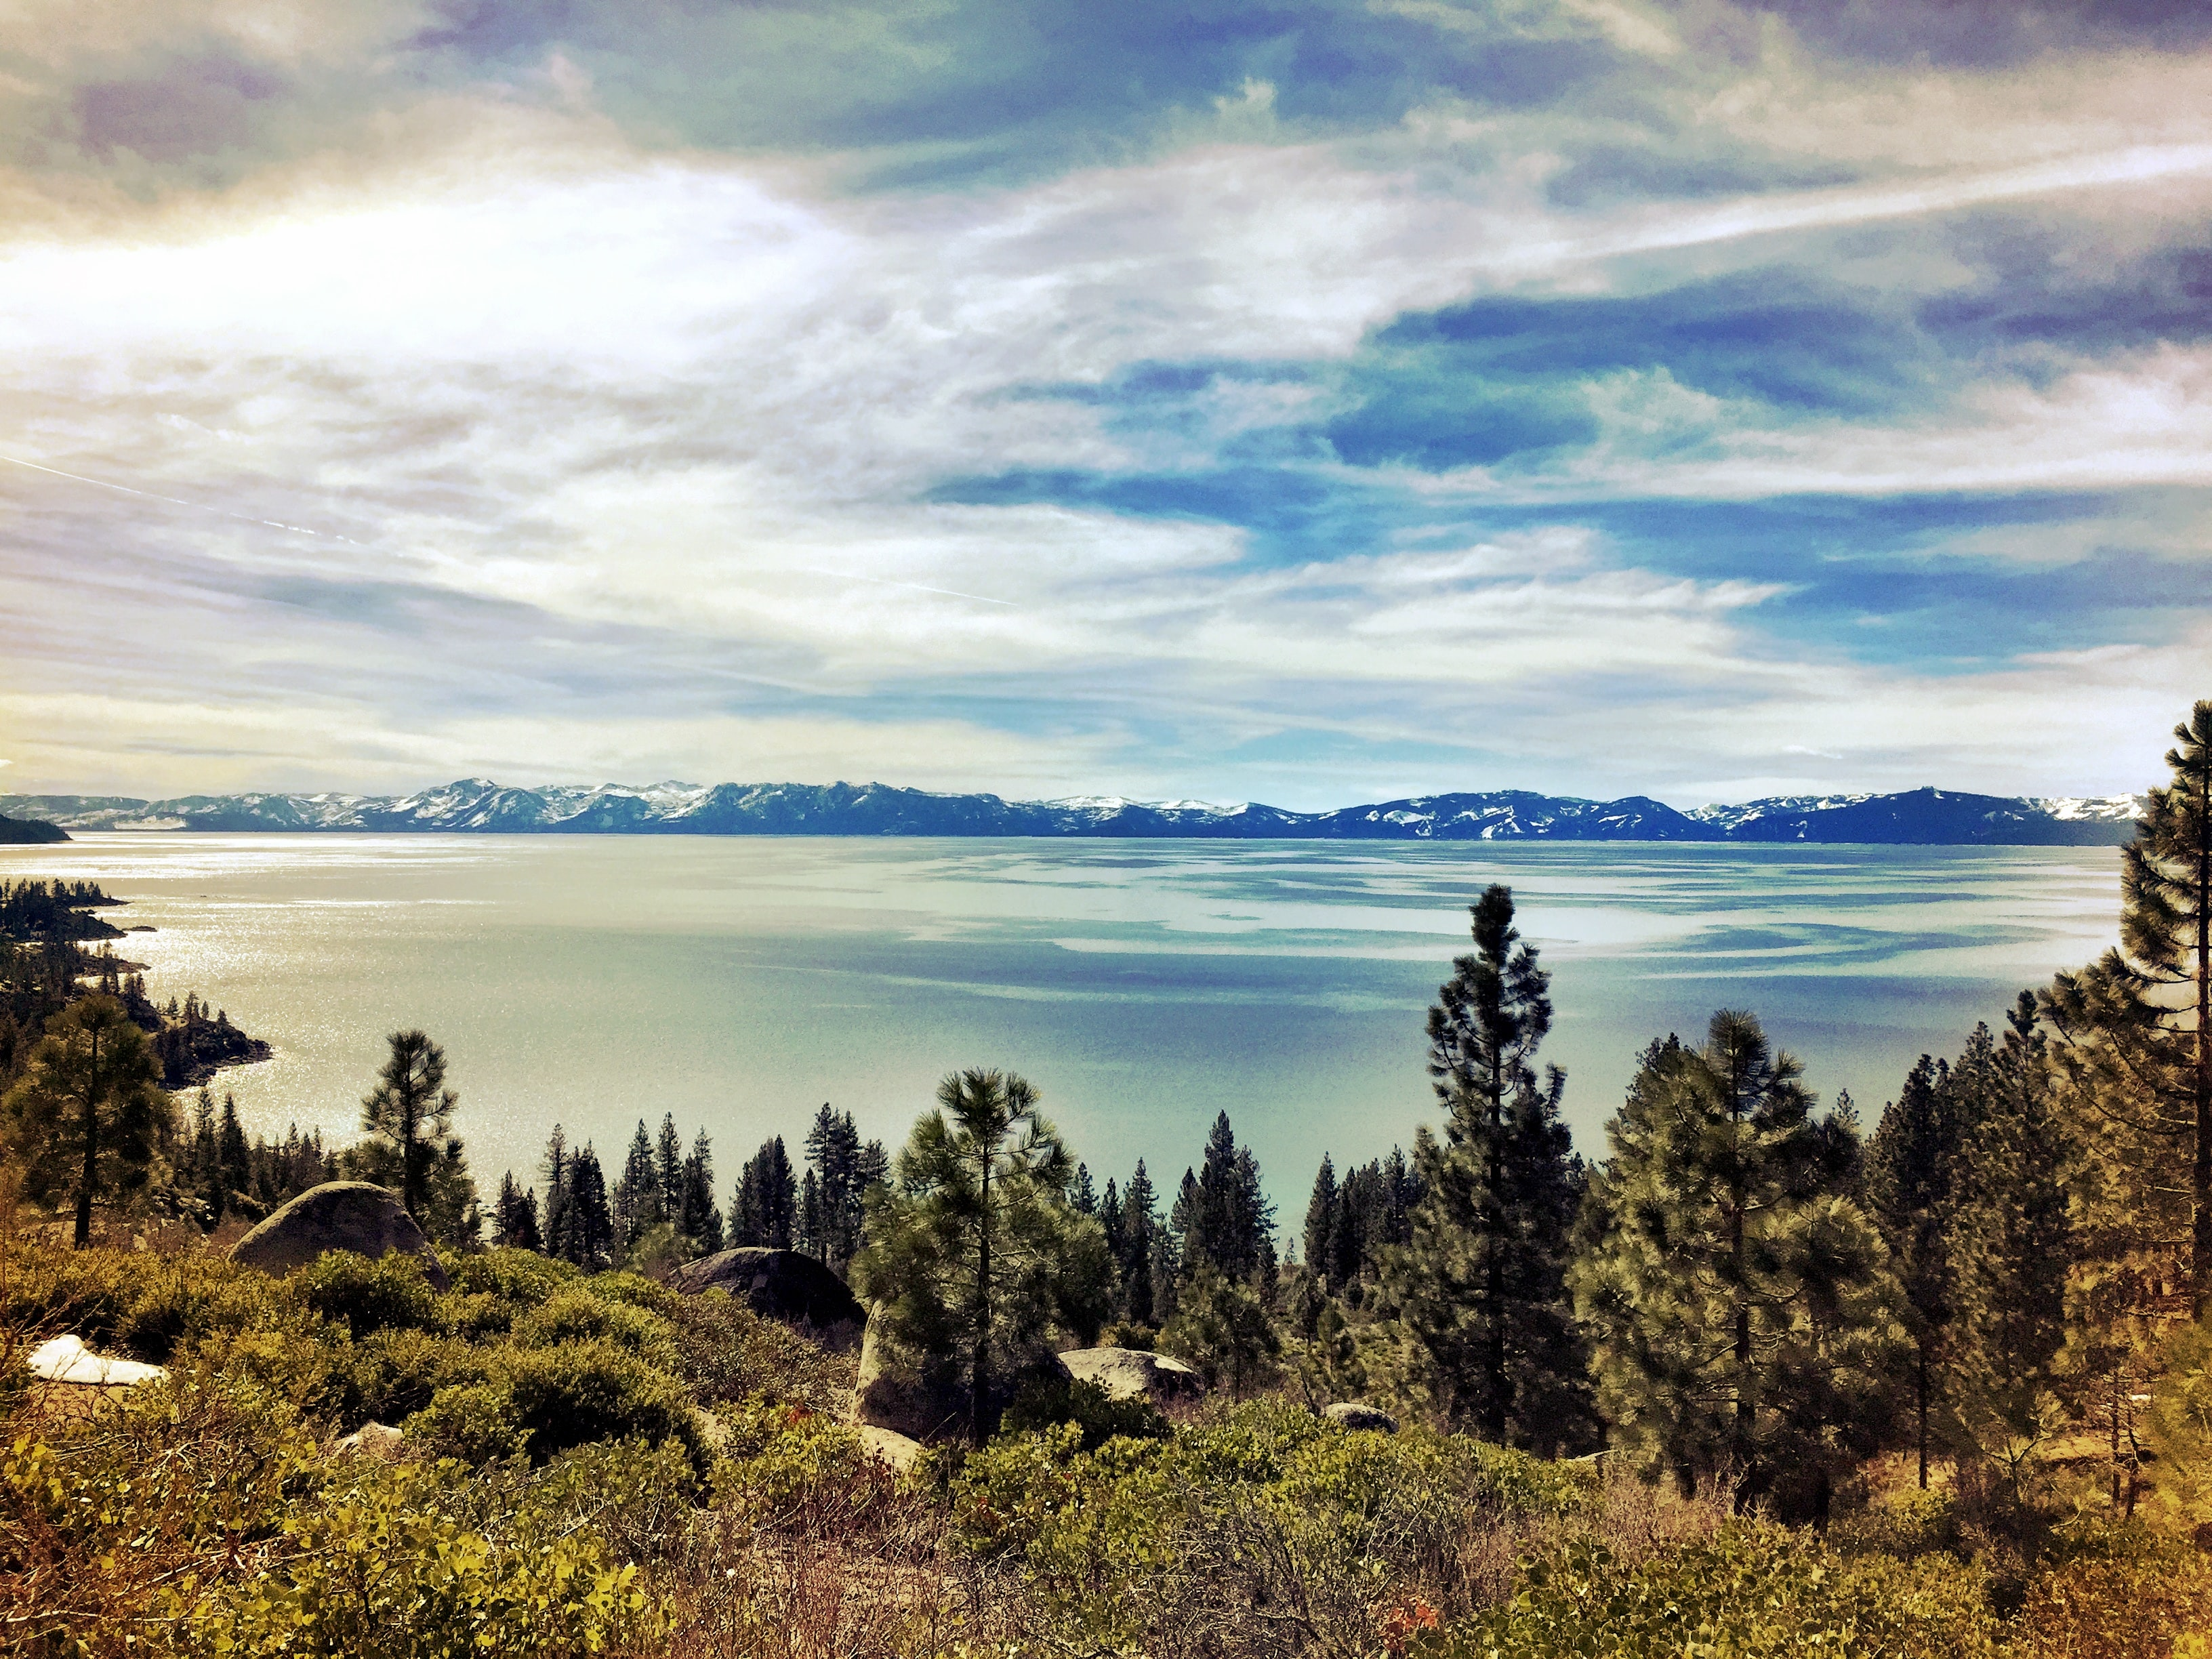
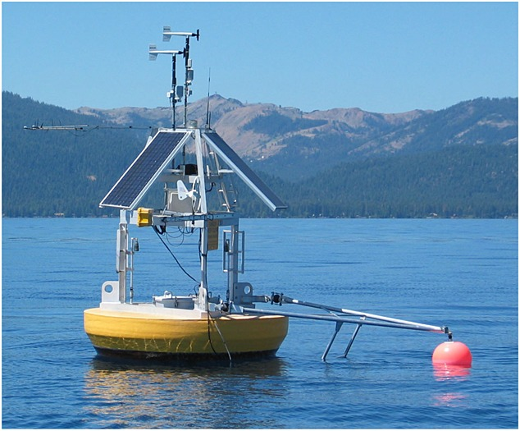
Benefits
The CE-QUAL-W2 HAB prediction tool will simulate HAB occurrences with greater precision.
The tool will provide a real-time understanding of how various environmental factors contribute to HAB dynamics, allowing for timely assessments that can lead to more proactive management.
The data generated will be instrumental in formulating effective mitigation strategies, potentially reducing the frequency and severity of HAB events by targeting identified key contributing factors.
The outputs will facilitate adaptive management practices, where strategies and responses can be continuously refined based on the latest predictive insights.
Accurately simulating HAB events for multiple possible future conditions will improve emergency response protocols, aiding in the preparation and deployment of resources to affected locations efficiently.

Slide 12
Benefits
Through early detection and management of HABs, the model will help protect ecosystem health and public safety, minimizing the adverse effects on wildlife and human populations.
By preventing or minimizing HAB occurrences, the model will indirectly aid in safeguarding local economies dependent on water-related industries such as fisheries, tourism, and recreation.
The outputs will improve communication and help to engage and educate stakeholders, including local communities, policymakers, and environmental organizations, fostering collaboration in HAB management efforts.
The development and refinement of the CE-QUAL-W2 HAB models represent significant scientific and technological progress in the field of ecological modeling and environmental management.

Slide 13

Questions?

